Slide 1
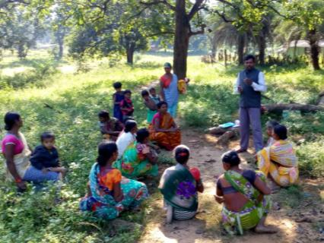
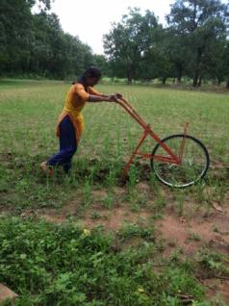
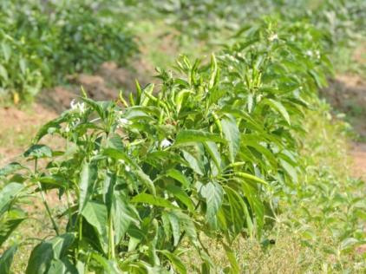
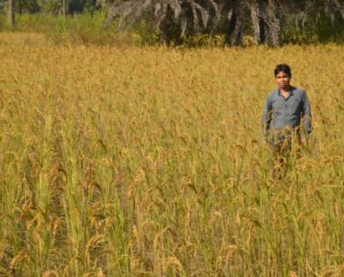
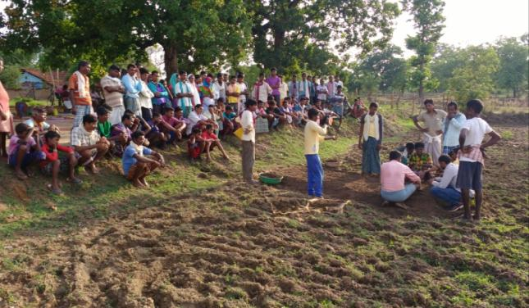
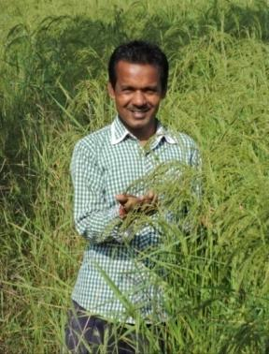
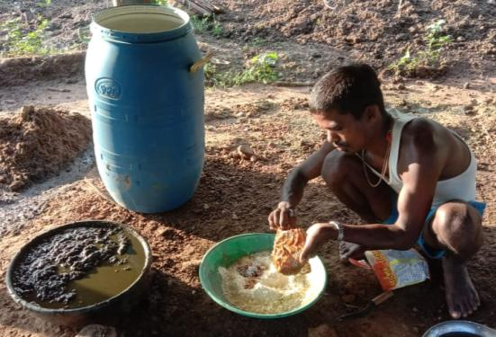
From Subsistence to Sustainability
Bhoomgaadi Organic farmer’s Producer Company Limited
An enterprise of Organic Farmers of Dantewada

Slide 2
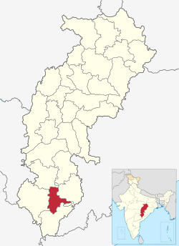
Dantewada
60% of the land is covered by forest 71% of the population is tribal Population density is just 123 per sq km Only 42% of the population is literate 57% families are Below Poverty 50% of the children are stunted 70% of the women are anemic

Slide 3
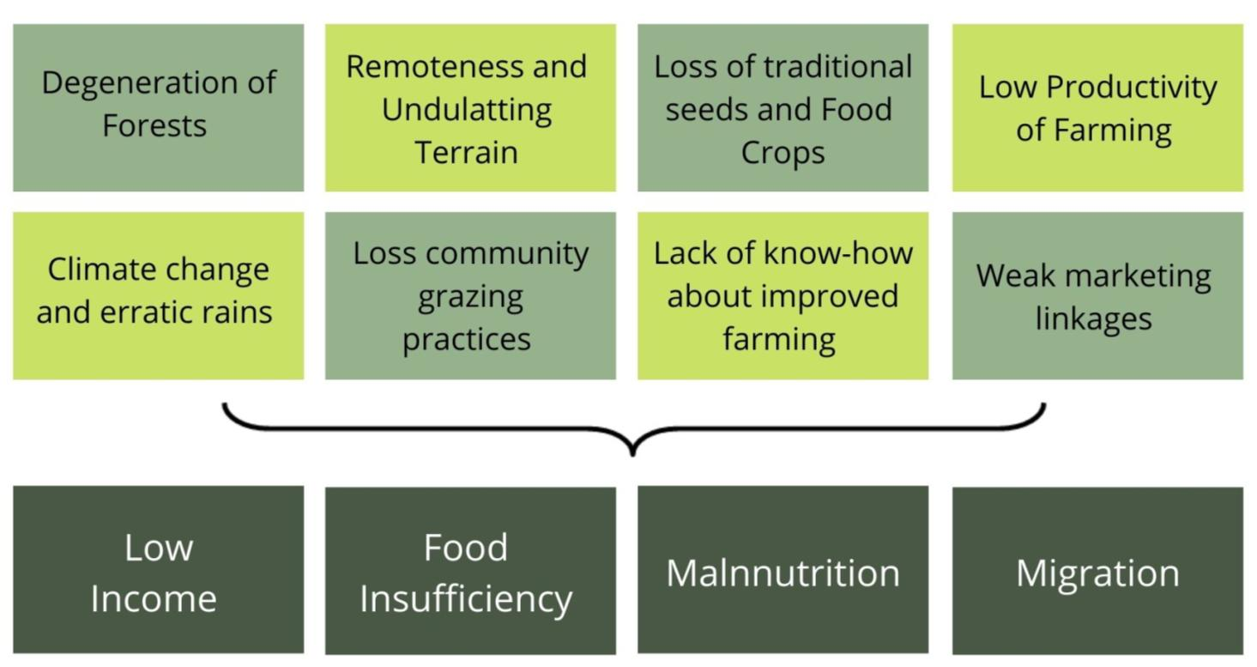
SWOT

Slide 4
Small, marginal and tribal farmers earning a sustainable livelihood from surrounding natural resources to ensure welfare of the family and live a dignified life
Vision

Slide 5
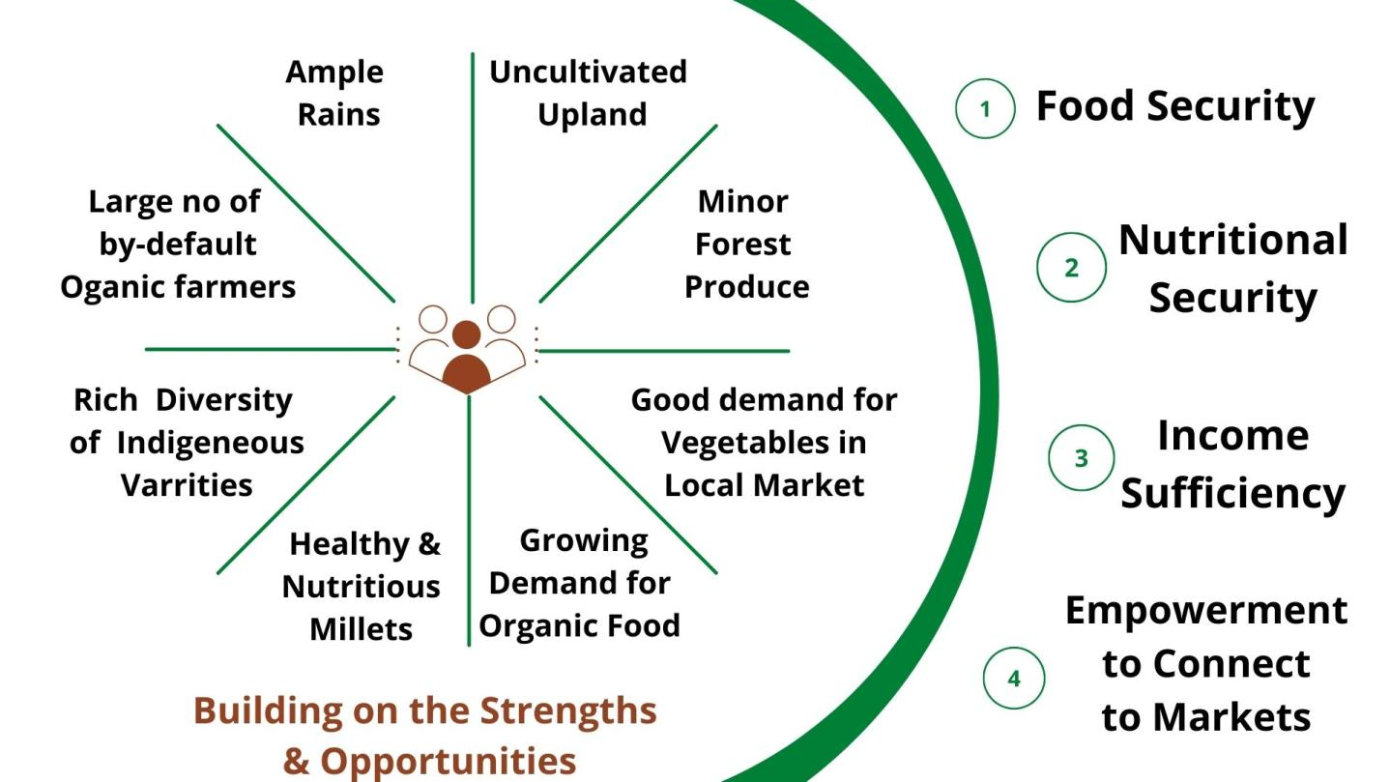

Slide 6
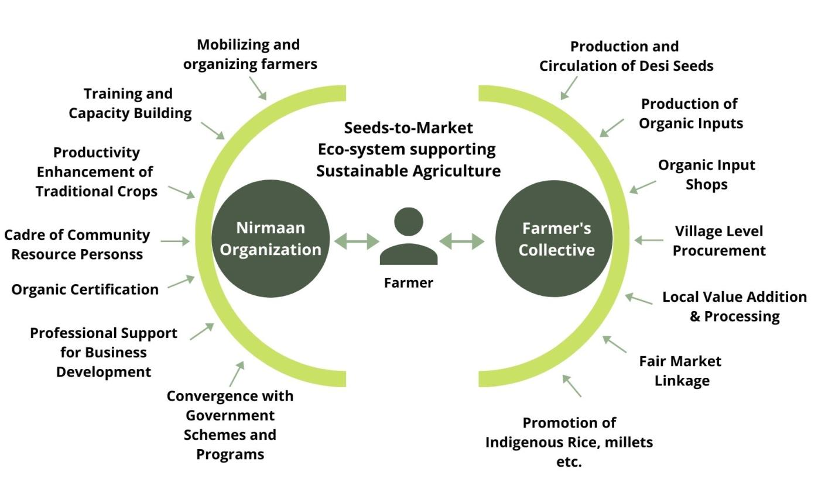
Support from the District Administration

Slide 7
Milestones over years
June 2016
40 Villages
Year 2018
125 Villages
27000 Ha.
Year 2022
65000 Ha. under LAC
Dec 2015
8 villages
Pilot Engagement

Slide 8
Where we are currently
Presence in 125 villages from Dantewada through a cadre of 130 resource persons and coordinators from the community who conduct regular trainings, provide handholding support to the farmers
9800+ farmers and 27000+ Ha land under PGS organic certification
2300+ farmers have adopted improved methods of cultivation so far
35% average increase in productivity of paddy due to adoption of SRI and other techniques
Circulation of 211 quintals of organic indigenous seeds among the farmers

Slide 9
No sale, promotion, distribution of chemical inputs is being done by any government agency in Dantewada
Farmers and Gram Panchayat bodies of 110 villages have passed resolutions to be declared as organic and proposal for 65000+ Ha area sent to the GoI under Large Area Certification (LAC)
Bhoomgaadi, an FPO with 3000 member farmers which sales products in 35+ cities, with current turnover of Rs. 70 Lakh
Local value addition that provides employment to 20 women and youth

Slide 10
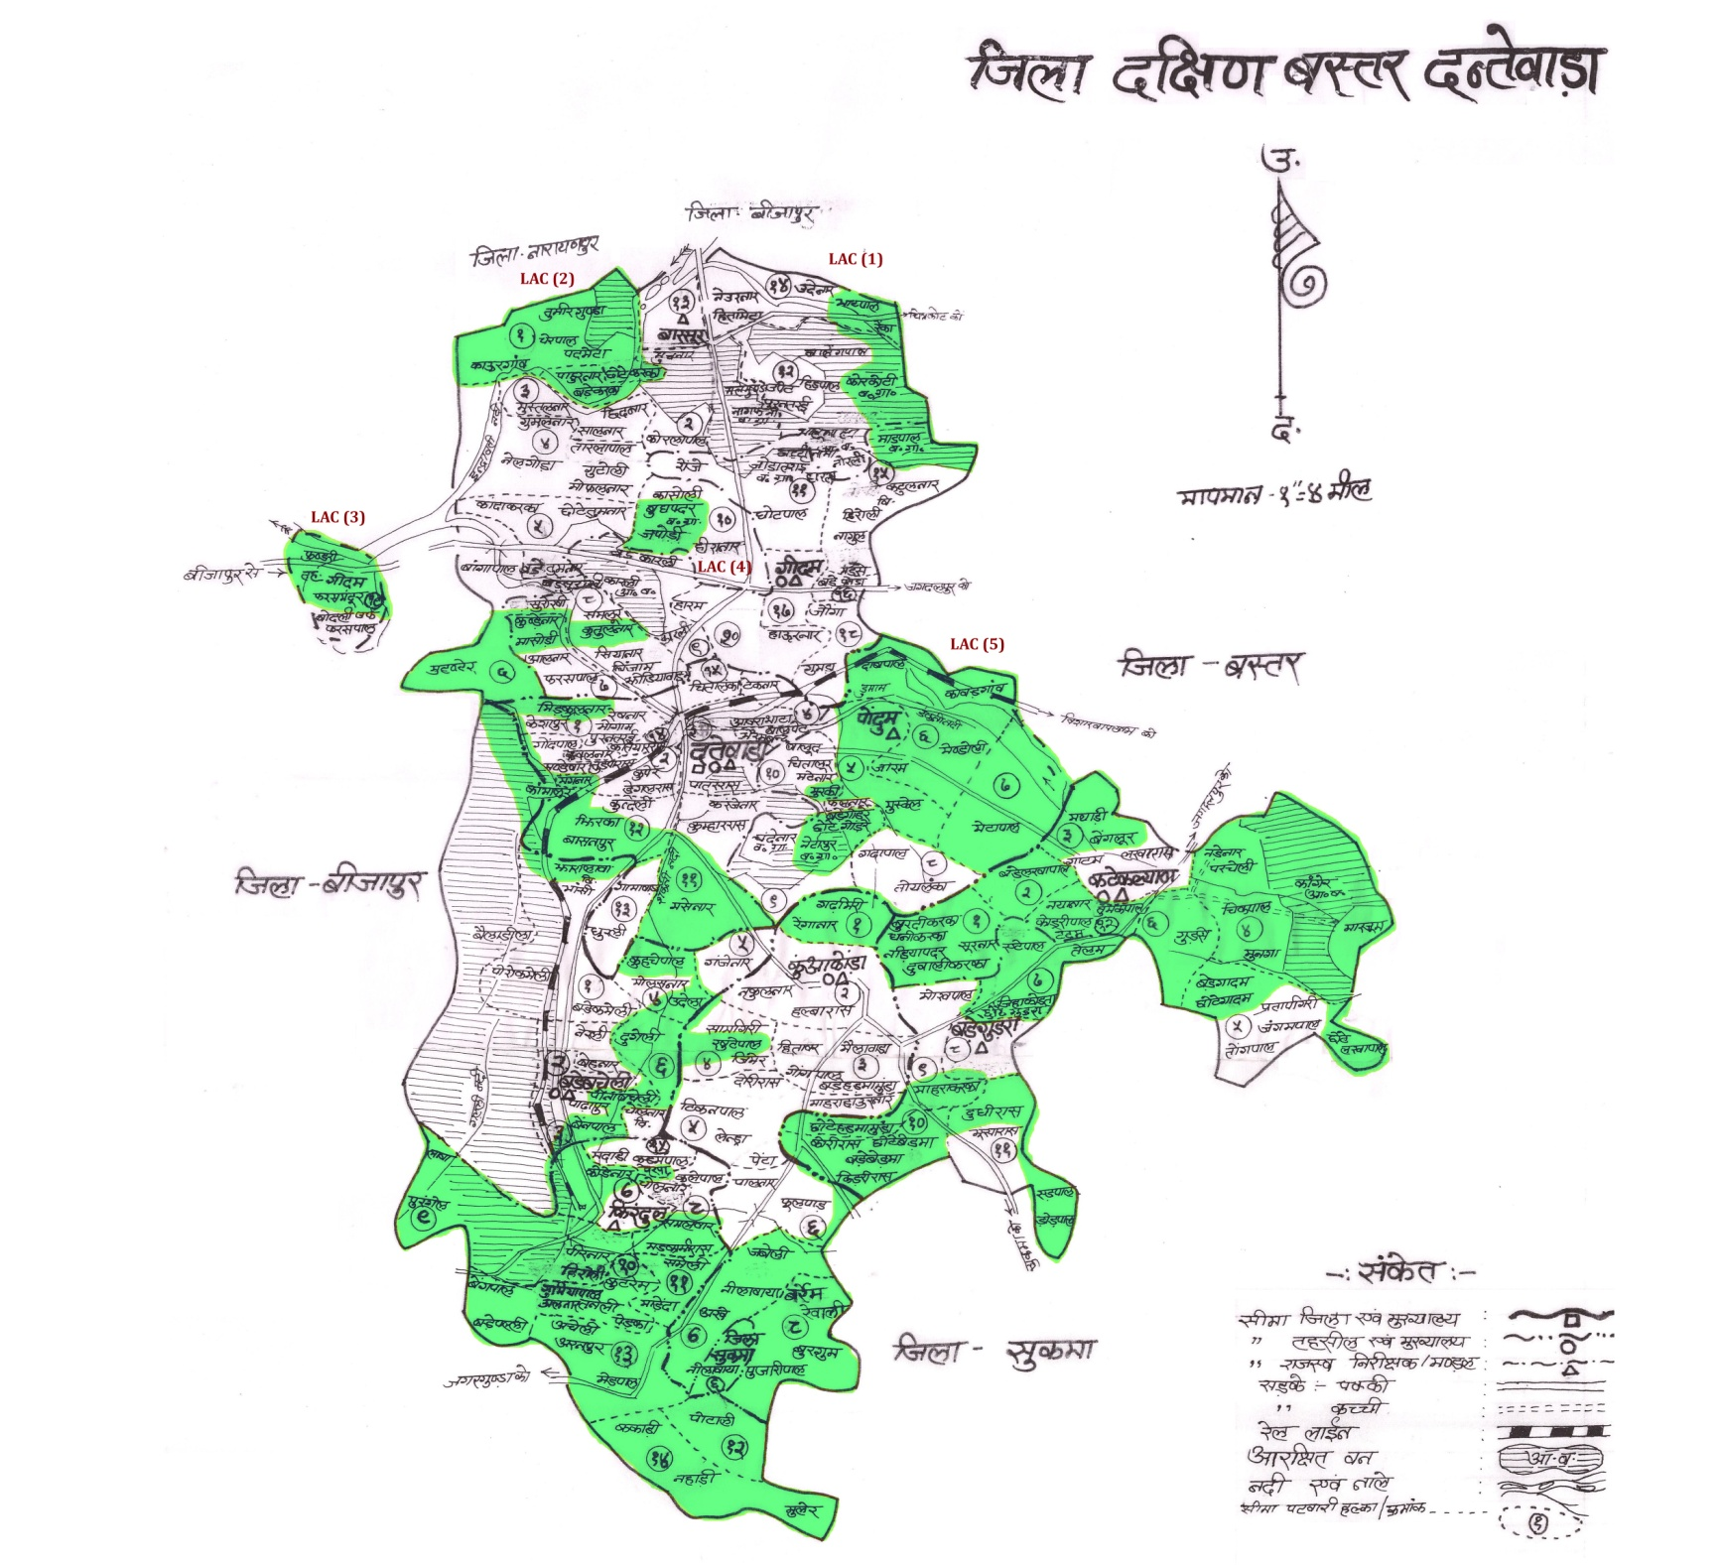

Slide 11
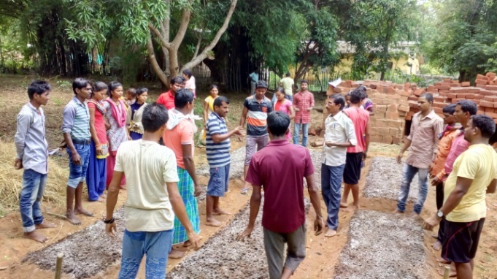
Team of 100 youth to work as “Jaivik Karyakarta” in 135 villages established through extensive trainings by experts with involvement of Nirmaan Organization

Slide 12
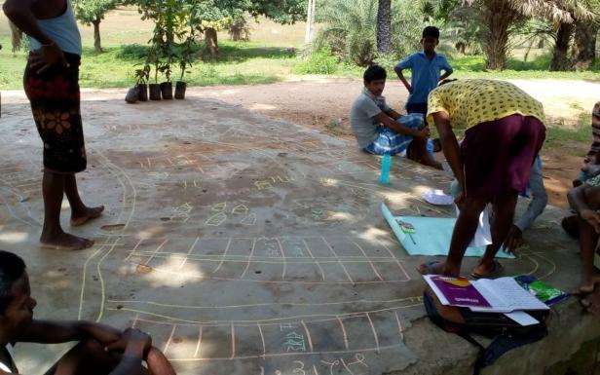
Resource Mapping by Jaivik Karyakarta to identify patches under Organic Cultivation

Slide 13
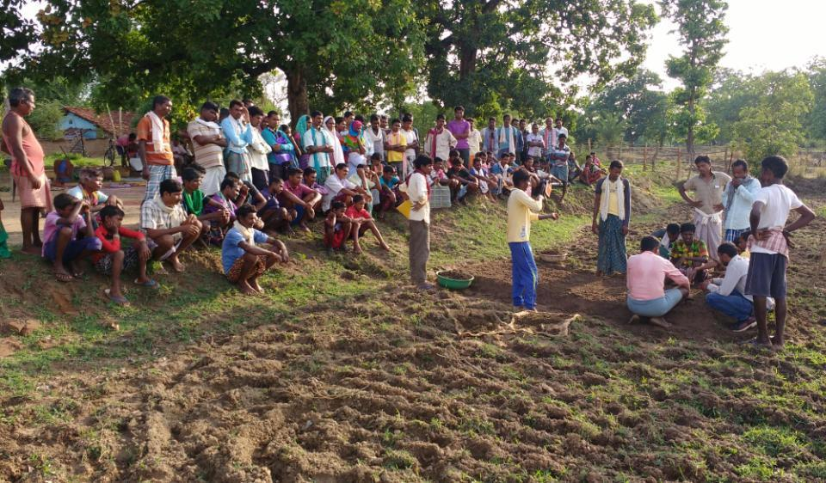
Training of farmers on nursery preparatoin for SRI cultivation of Paddy
Village: Gumda

Slide 14
Extensive training of farmers in techniques of Organic Cultivation
Village Bhatpal, Block Geedam

Slide 15
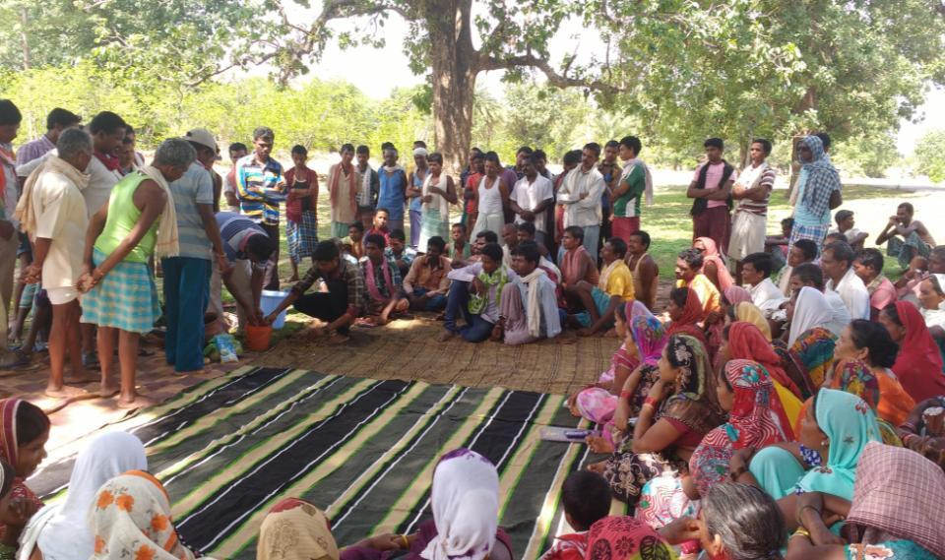
Women SHGs and Fermer’s groups learning avidly methods of organic seed treatment, Village: Kuakonda

Slide 16
MARKET
Bhoomgaadi Organic Farmer’s Producer Company Limited
12 Directors from 12 Clusters
Directors from Each Cluster Level
Authorized Capital: 50 Lakh
Paid up Capital: 29.9 Lakh
Organic Farmer’s and Women Groups
Total 2727 farmers 1952 Male and 775 Female, 80% Tribal

Slide 17
Team Structure of Bhoomgaadi
Chief Executive Officer
Operations Lead
Procurement and Storage in Charge
Primary Processing Unit Team
Sales and Marketing Lead
Jaivik Bazar Manager
Secondary Processing Team
Café Aadim Team
95% of the team from Dantewada

Slide 18
Modus Operandi of Procurement and Operations
Finalization of Procurement rates after consultation with farmers in AGM
Procurement at Village/Cluster level: 127 Villages
Payments to the farmers in accounts (90% initially - 10% afterwards)
Storage at cluster level godowns spread across district
Transportation to Central Processing Unit at Dantewada for Processing (Hub-Spoke Model)
Value addition, packaging and branding at the processing unit at Dantewada

Slide 19
Women SHG members approving the rates of procurement of Bhoomgaadi

Slide 20
Comparison
Produce | Comparison with Local Haat Bazar Rates
1) Coarse Paddy | 20-30% Higher
2) Fine Paddy | 20-60% Higher
3) Red Rice Paddy | 20-60% Higher
4) Fine Red Rice Paddy | No Prior Organized Market
5) Medium Aromatic Paddy | No Prior Organized Market
6) Fine Aromatic Paddy | No Prior Organized Market
7) Black Rice Paddy 8) Basmati Paddy | No Prior Organized Market
9) Little Millet 10) Kodo Millet 11) Barnyard Millet 12) Finger Millet | 0-10% Higher (No prior organized Market for some Millets
13) Sorghum | No Prior Organized Market

Slide 21
Comparison
Produce | Comparison with Local Haat Bazar Rates
14) Indigenous Maize | No Prior Organized Market
15) Udad 16) Kulthi 17) Cow Pea (Lobiya) | Comparable to retail Haat Bazar Rates
18) Arhar 19) Moong | Comparable to retail Haat Bazar Rates
20) Niger (Ramtil) 21) Mustard | Comparable to retail Haat Bazar Rates
22) Sesame (Til) | No Prior Organized Market
23) Roselle Petals | No Prior Organized Market
24) Roselle Seeds | No Prior Organized Market
25) Turmeric Raw | No Prior Organized Market
26) Coriander | No Prior Organized Market

Slide 22
Current Product Catalogue
S. No. | Category | Products
1. | Aromatic Rice | 1) Javaphul 2) Lokati Machi 3) Dubraj, 4) Sugandha 5) Kalajira 6) Basabhog 7) Basmati
2. | Medicinal Rice | 8) Red Rice 9) Brown Rice 10) Brown Basmati 11) Red cum Brown Rice 12) Diabetic Friendly Rice
3. | Other Rice Varieties | 13) HMT 14) Devbhog 15) Dosa Rice
3. | Poha | 16) White Poha 17) Brown Poha 18) Red Poha 19) Popped Rice
4. | Millets | 20) Little Millet 21) Kodo Millet 22) Raagi 23) Raagi Flour
5. | Whole Pulses | 24) Moong 25) Udad 26) Kulthi 27) Lobiya
6. | Split Pulses (Using grind stones) | 28) Arhar Dal 29) Moong Dal 30) Udad Dal
7. | Spices and Others | 31) Turmeric Powder 32) Dhaniya Powder 33) Amchur Powder 34) Deseeded Tamarind 35) Niger 36) Roselle Petals Powder

Slide 23
Current Marketing Scenario
Marketing under the brand name “Aadim”
Also market processed products in bulk
Marketing in more than 38 cities in 18 States/ UTs
Selling in Tribes India stores across India
Other buyers – Organic Stores and Chains, Consumer Groups and Institutional Buyers
Turnover: 2019-20 – Rs. 50 Lakh, 2020-21 – Rs. 70 Lakh

Slide 24
List of Cities
S. No. | State / UT | City
1. | Andhra Pradesh | 1) Vijaywada 2) Visakhapatnam
2. | Assam | 3) Guwahati
3. | Chandigarh | 4) Chandigarh
3. | Chhattisgarh | 5) Dantewada 6) Bacheli 7) Jagdalpur 8) Bhilai 9) Raipur 10) Bilaspur 11) Dhamtari
4. | Delhi | 12) Delhi
5. | Gujrath | 13) Ahmedabad
6. | Haryana | 14) Faridabad 15) Gurugram
7. | Jharkhand | 17) Ranchi
8. | Karnataka | 18) Bangalore 19) Shimoga
9. | Keral | 20) Kozikode 21) Kochin 22) Trivandrum
10. | Madhya Pradesh | 23) Bhopal 24) Indore
11. | Maharashtra | 25) Mumbai 26) Pune 27) Nashik
12. | Rajasthan | 28) Jaipur 29) Udaipur

Slide 25
List of Cities
S. No. | State / UT | City
13. | Tamilnadu | 30) Chennai 31) Coimbture
14. | Telangana | 32) Hyderabad
15. | Uttarpradesh | 33) Allahabad
16. | Uttarakhand | 34) Dehradun 35) Nainital
17. | Punjab | 36) Jalandhar 37) Ludhiyana
18 | Odisha | 38) Bubaneshwar

Slide 26
Organic Produce Processing Unit Provided to Bhoomgaadi with support of district administration of Dantewada
Facilities available:
S.No. | Name of Unit | Capacity
1. | Semi Automatic Rice Mill | 5 Q / hr
2. | Small Millet Processing Unit | 1 Q/ hr
3. | Poha Processing Unit | 3 Q/ hr
4. | Pulverizer | 10 kg / hr
5. | Tamarind Processing Unit | 10 kg /hr
6. | Basic facility for branding and packaging
Around 10-20 women and youth from surrounding villages engaged in processing

Slide 27
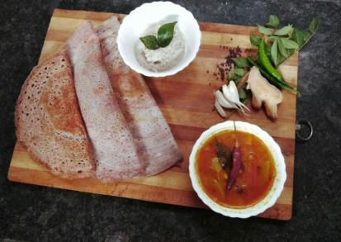
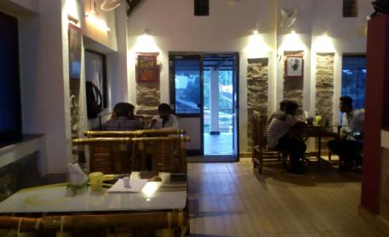
Local, Organic and Health Food
To popularize indigenous rice, millets and traditional vegetables
Experimentation with indigenous ingredients and modern recipes
8 youth from surrounding villages
Great potential to expand in various cities in state

Slide 28
A glance of a presentation made by Directorate of Agriculture, Chhattisgarh
Dantewada the only district in the state where no Govt. agency distributes chemical inputs

Slide 29
The erstwhile C.M. of Chhattsgarh Dr. Raman Singh releasing
the brand “Aadim” of organic farmers of Dantewada

Slide 30
NITI Ayog CEO, Mr. Amitabh Kant Interacting with the farmers of Bhoomgaadi

Slide 31
NITI Ayog C.E.O, Mr. Amitabh Kant visiting the Processing unit of Bhoomgaadi
with the district Collector Mr. Saurabh Kumar (I.A.S.)

Slide 32
Nirmaan team interacting with Hon’ble C.M. of Chhattisgarh, Mr. Bhupesh Baghel

Slide 33
Bhoomgaadi Farmers presenting organic rice products to
The Hon’ble Prime Minister Narendra Modi

Slide 34
Mr. Ludru Ram Nag, a share holder of Bhoomgaadi presenting Honorable President of India, Ramnath Kovind with the organic rice marketed by Bhoomgaadi under the brand “Aadim”

Slide 35
Challenges
Organic Certification
PGS – Third Party No Connection, Challenges in Export
Availability of small scale technology for processing
Challenges with big trade and market distortions
Mandi system
High losses due to lack of infrastructure for storage
Logistic due to remoteness
Availability of good quality human resource
The need for investing in the capacities of the farmers

Slide 36
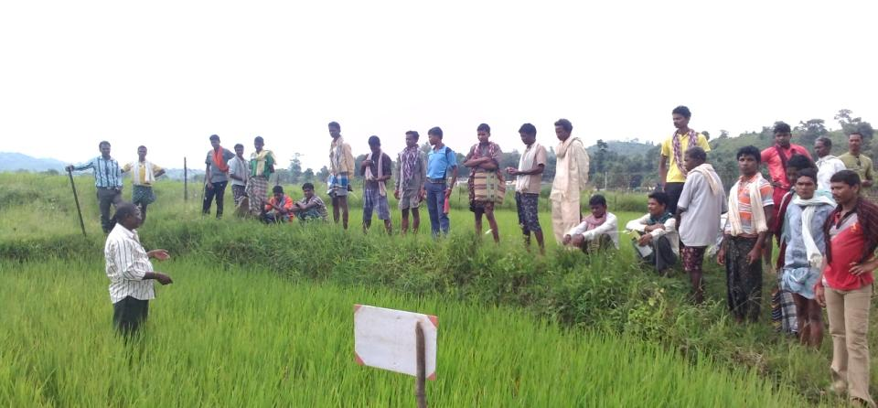
Thank You!
Contact Name: Akash Badave
Email: akashsbadave@gmail.com
Phone: 9406489449 / 9981234473
Registered Address:
Old Janpad Bhavan, Near New Petrol Pump, Bacheli Road,
Dantewada, Chhattisgarh, PIN: 494449

